Slide 1
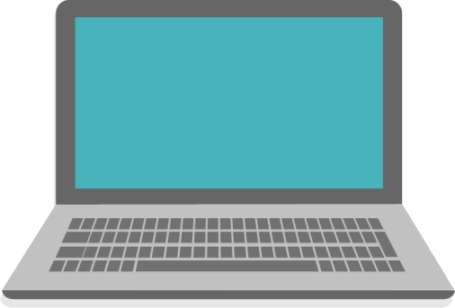
Direct and Reverse Connections
YOU

Slide 2

How the connection happens? – Direct Connection
YOU
1) Host / IP Address + Port
FRIEND
2) Socket

Slide 3
Problems with direct connection
It difficult to get IP address
Even if we get his IP address the IP address is Dynamic IP so its always changing
Even we could get regular updates to the dynamic IP address the computer has bunch of firewalls which makes it impossible to get to his computer

Slide 4
Reverse Connection
1) Host / IP Address + Port
HACKER’S SERVER
2) Socket
VICTIM

Slide 5



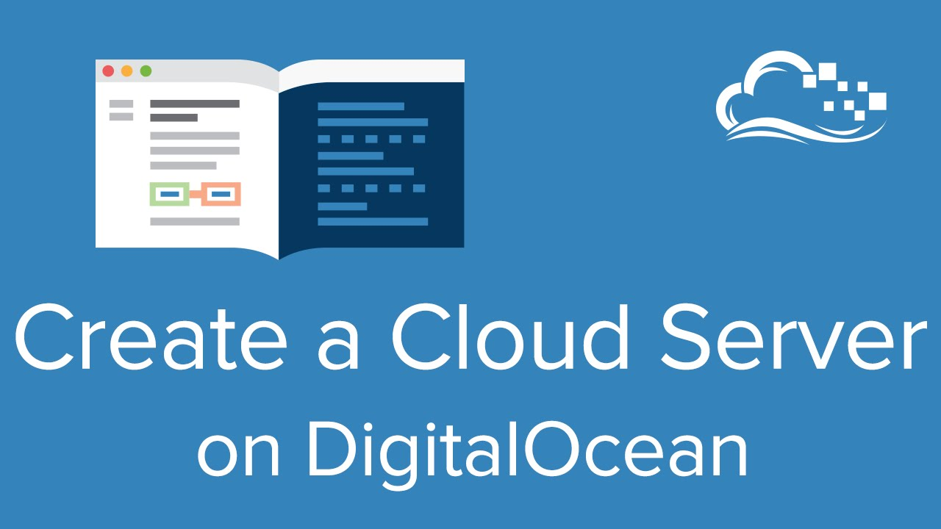
ATTACKER
VICTIM

